Slide 1
Orion
Comparable Sales Report & Named Tables
2024 ORION USERS CONFERENCE

Slide 2
Modifying the Comparable Sales Report
.

Slide 3
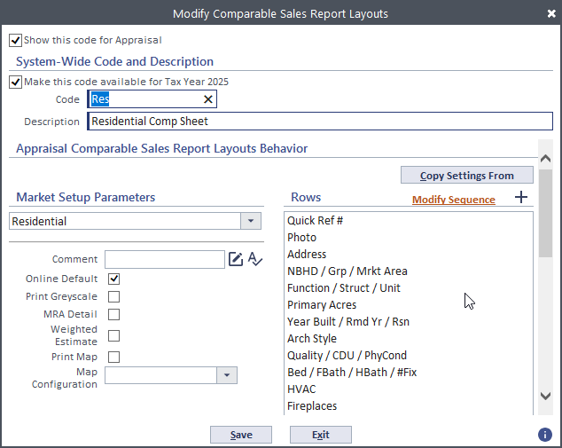
2024 ORION USERS CONFERENCE
Reasons To Modify A Comparable Sales Report
The default Comp Report does not meet your county’s needs
Your County has added new variables that need to be displayed on the Comp Report
You would like to see the amount of adjustment being made between the Subject and each comp
You only want to display data that was used within that subject’s specific Market Model
You want to rearrange what data fields are displayed together to free up more lines to add more to the Comp Report
2024 ORION USERS CONFERENCE

Slide 4
County Examples
Wyandotte
Shawnee
Riley
Residential Comp Sheet
Residential Comp Sheet
Basic Residential Comp Sheet

Slide 5
County Examples
Ellis
Lyon
Comp Sheet - Basic
LYCO Final Review Program Comp Sheet

Slide 6
County Examples
Wyandotte
Miami
Wyandotte
Individual Model Adjustment
Adjustments for Appraiser Use Only
Appeal Comp Sheet

Slide 7
Setting Up A Comp Report
2024 ORION USERS CONFERENCE
Report Use
Variables
Define Row Fields
Spacing
Determine the business process you need address by creating/modifying additional comp reports
If new variables are needed such as displaying multiple variables on one line – create those prior to setting up the comp report
Enter the name of the row as you would like it displayed on the report. The name can be up to 30 characters in length, including spaces. To have a blank row, leave this field blank.
Max of 41 rows available on one page. Photos and Situs Address will use more than one line

Slide 8
Data Types
Variable
None
CAMA Code
prints the results of any of the market variables in the market calculation definition group.
inserts a blank row in the report. This allows you to provide a visual break between the sections of the report.
prints the CAMA code and/or description for the property.
Pre-defined
Adjustments
Flags
selects from a set of pre-defined calculations that have characteristics that cannot easily be handled with user-defined calculations.
prints the amount of adjustments made to each sale property. These adjustments print for the sale properties only after you specify the market variable.
prints flags that are on specified sale properties.
Thumbnail Photo
Photo-separate Page
includes a thumbnail picture of the property.
prints property pictures on a separate page. No additional options are available for this selection.
2024 ORION USERS CONFERENCE

Slide 9
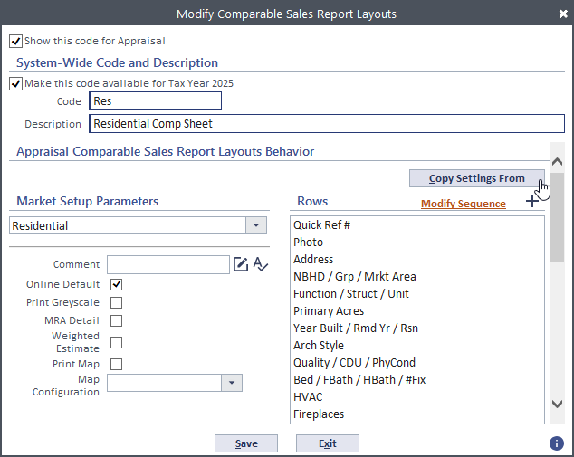
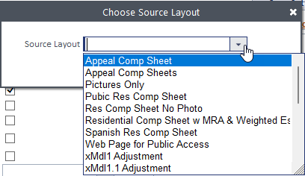
Copying Comp Report Formats
Save time when creating a new Comp Report by using the Copy Settings From button.
You can always delete unwanted rows and add new ones as needed.
Appeal Comp Report
Model specific Comp Report

Slide 10
Adding the MRA and Weighted Estimate Reports
To view the current MRA and or Weighted Estimate on your comp report which was included in the last patch you will need to go into Maintain Comparable Sales Report Layouts and select a report (or create a new one), then select the option to include MRA Detail and Weighted Estimate.

Slide 11
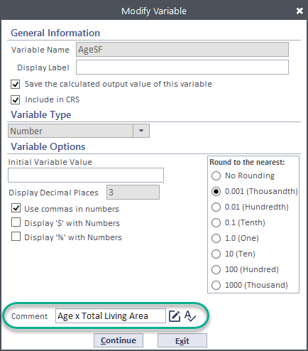
Variable Formulas (Comments)
The MRA report allows for the formula to be added onto the report.
Update the Comment field of the variable in
Market Setup – Calculation Setup – Calculation Definition Groups
Open the variable needing the formula populated
Enter the formula into the Comment field
WyCo Comp Report Example

Slide 12
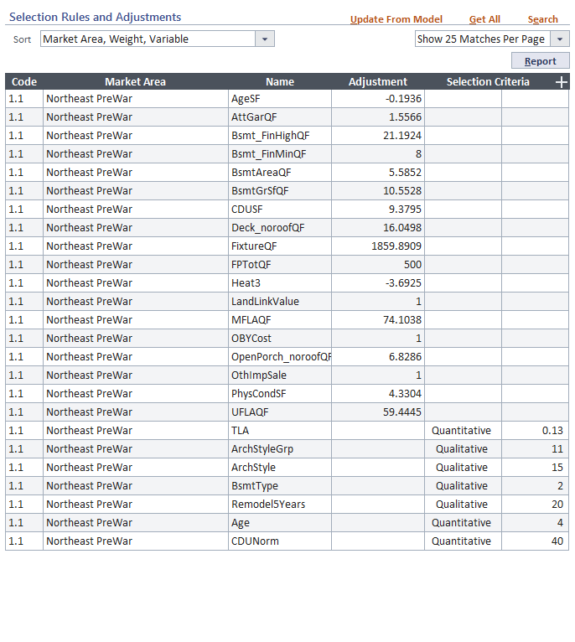
Displaying Adjustments between the Subject and each Comp
Each Mkt Model Needs A Comp Report
To correctly display the adjustment differences, create a comp report for each market model.
Use the Data Type Adjustments then select each variable utilized in the market model.
The MRA Coefficient values for the Adjustment report will pull from the Selection Rules and Adjustments report – make sure they are updated.
When using WtArea in regression, the various variables used in the statement must be added separately to the selection rules.
2024 ORION USERS CONFERENCE

Slide 13
ORION
Named Tables
2024 ORION USERS CONFERENCE

Slide 14
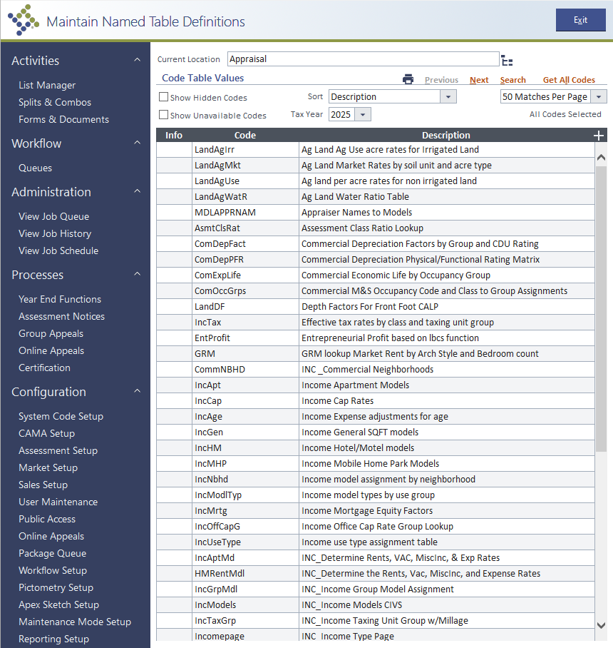
Orion Name Tables
Named table lookups provide a mechanism for any calculations to easily access standard system calculation table values that are not specific to a calculation definition.
A named table lookup is globally available to any calculation that needs to call it. Inputs, outputs, and values are configured when defining the named table lookup, which can then be used in a statement.
Named Tables are located in:
CAMA Setup
Market Setup
Assessment Setup
Named Tables are not versioned – save versions in Excel if needed
2024 ORION USERS CONFERENCE

Slide 15
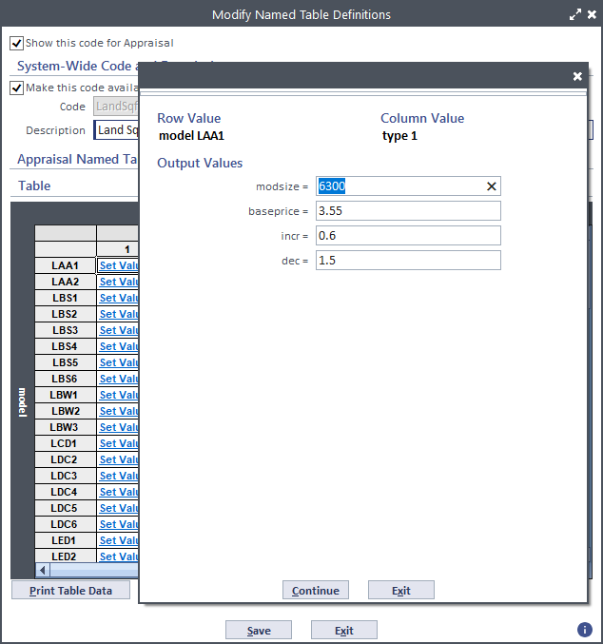
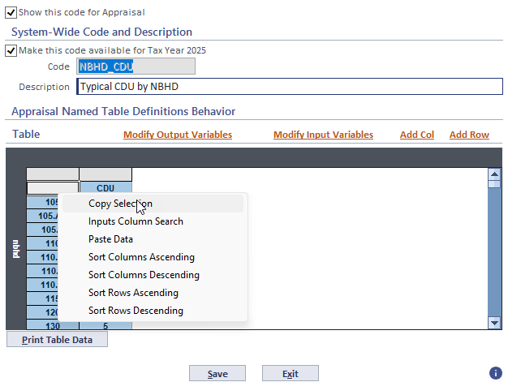
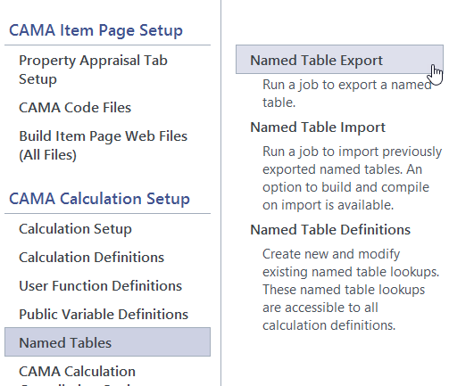
Updating Tables
2024 ORION USERS CONFERENCE
Manually
Copy & Paste
Export/Import
Manually key information into rows/fields.
Quickest option for minimal changes.
Time consuming and extra steps for numerous changes.
Copy and paste table data between Orion and Excel.
Good option for numerous changes and to update Orion tables that exist in Excel workbooks (nbhds, land, depreciation, etc).
Does not always paste into Excel without additional formatting needed.
Export and Import table data between Orion and Excel.
Quickest way to make numerous changes. No formatting needed.
Creates a new worksheet and additional steps needed if templates need updating.

Slide 16
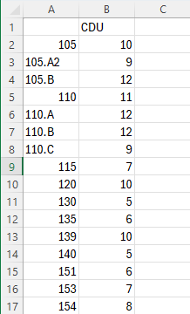
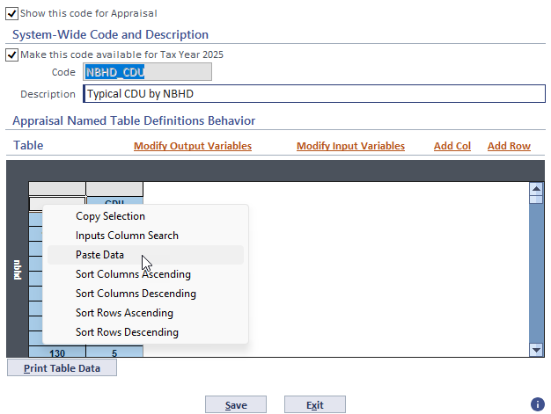
2024 ORION USERS CONFERENCE
Copy & Paste
Open the Orion table that needs updating
In the cell above the row names, right click Copy Selection
Paste into Excel workbook
Make edits in Excel
Copy the table including top row
Go back to the Orion table, in the cell above the row names, right click Paste Data

Slide 17
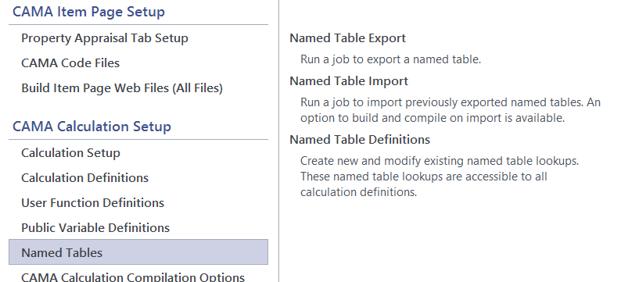
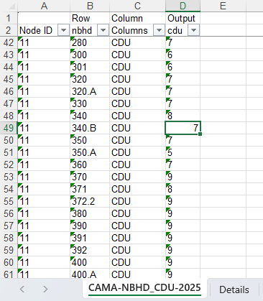
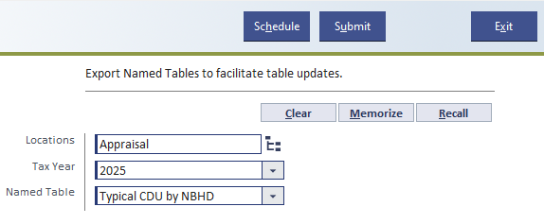
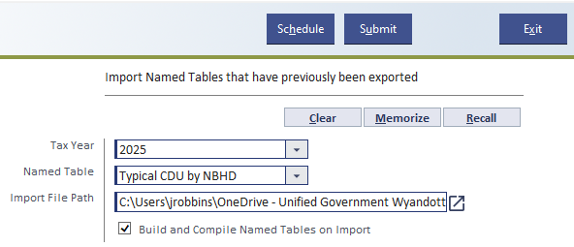
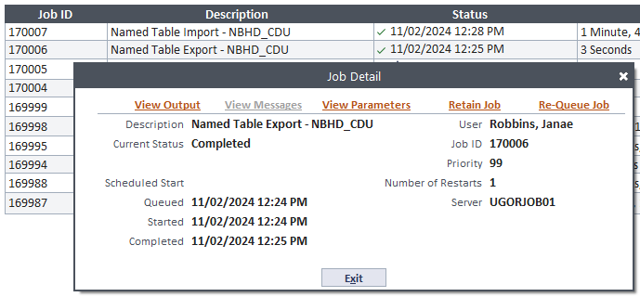
Export
Import
Click on Named Tables, Named Table Export
Select Tax Year and Named Table, Submit
Once the job completes, View Output and Save
Open saved table in Excel
Make any edits needed – do not alter columns
Save workbook
Click on Named Tables, Named Table Import
Select Tax Year, Named Table, and Import File Path (Excel table) – Default Build & Compile Checkbox, Submit
Named Table will be updated
2024 ORION USERS CONFERENCE

Slide 18
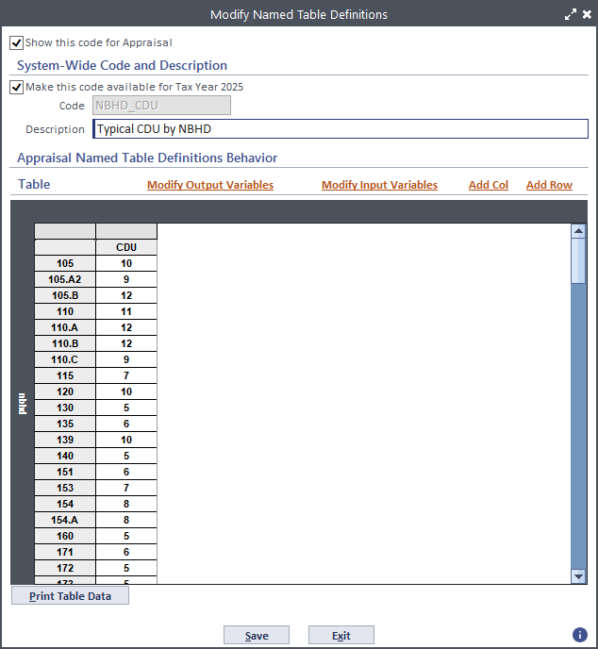
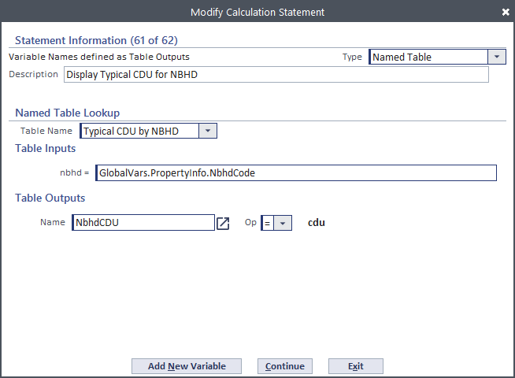
Named Table Example
WyCo: Nbhd CDU
Created to add each Nbhd’s typical CDU onto the ResBldg line. then using a Message variable (hope to add as Validation error), calc statement, determine if a parcel’s CDU matches the typical and if not, a CDU Reason is populated. If no CDU Reason code exists, the parcel will error.

Slide 19
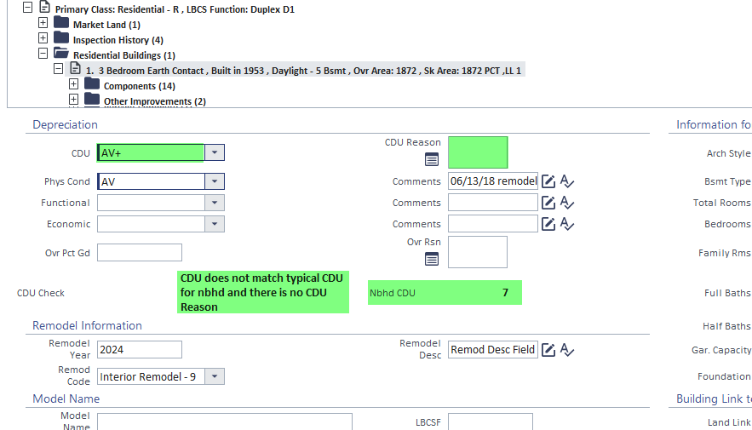
Setting Up A Named Table
Named Table
Create the CDU table
Calc Def Group:
Message CDU variable
Calc Def Statement:
Create Named Table output for NbhdCDU
Create If Then statement to compare CDU to NbhdCDU and then to the CDU Reason code field
Updated Item Page
Item Page – Res Dwellings: Configure Page Layout
Drag Variables into the correct column and row.
Build & Compile
Build then Compile. If fields are not displaying correctly, delete the Cache

Slide 20
Questions
Suggestions

Slide 21
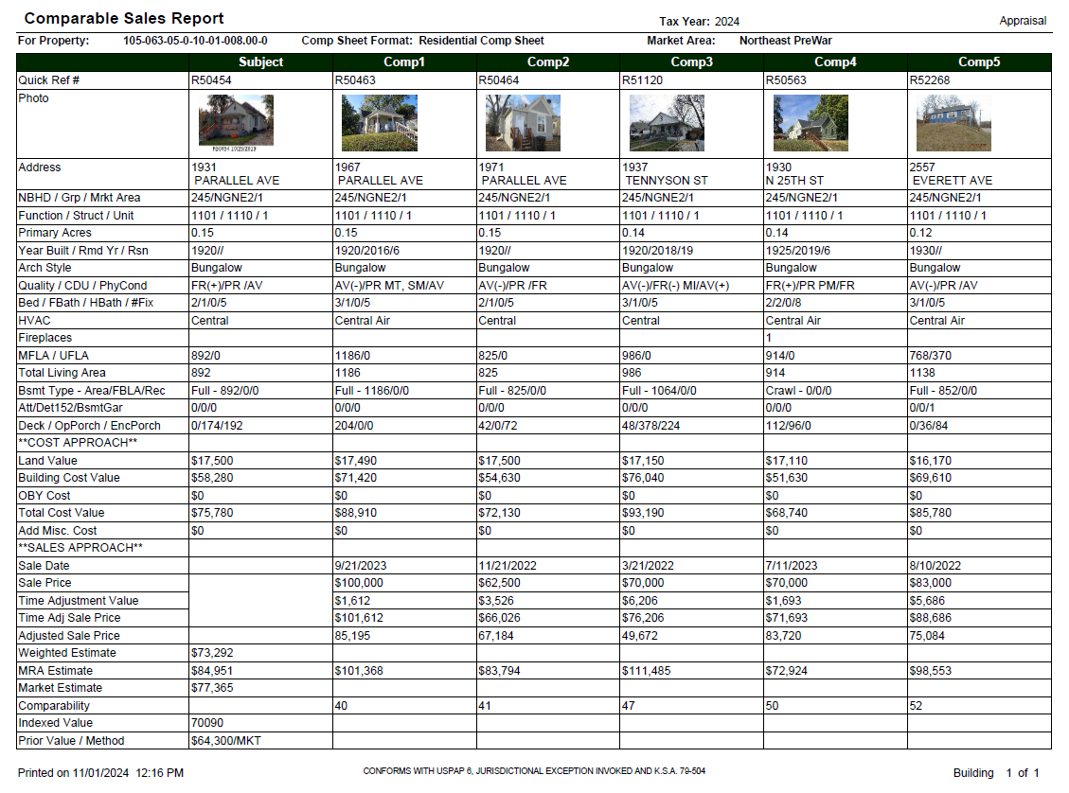
Wyandotte

Slide 22
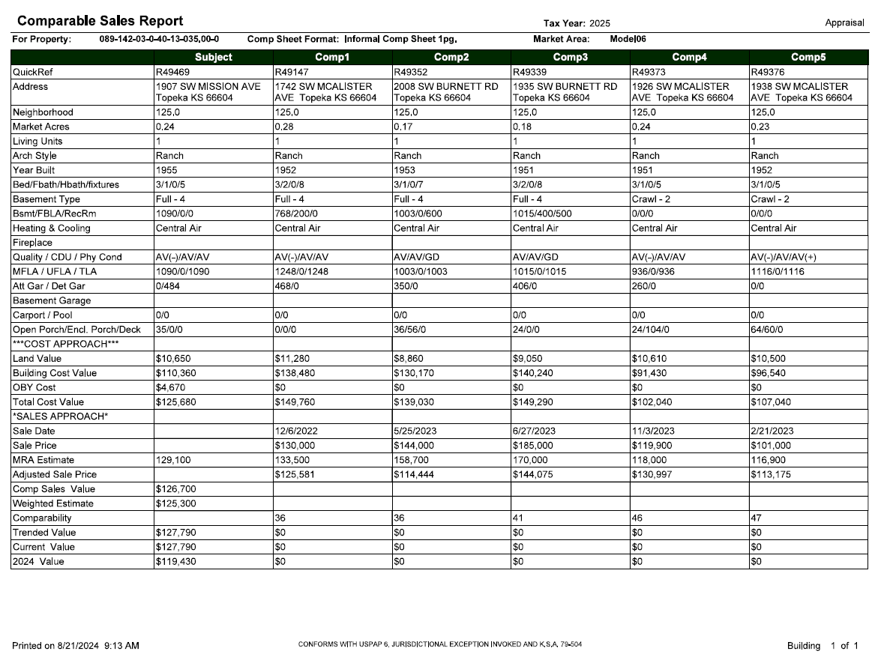
Shawnee

Slide 23
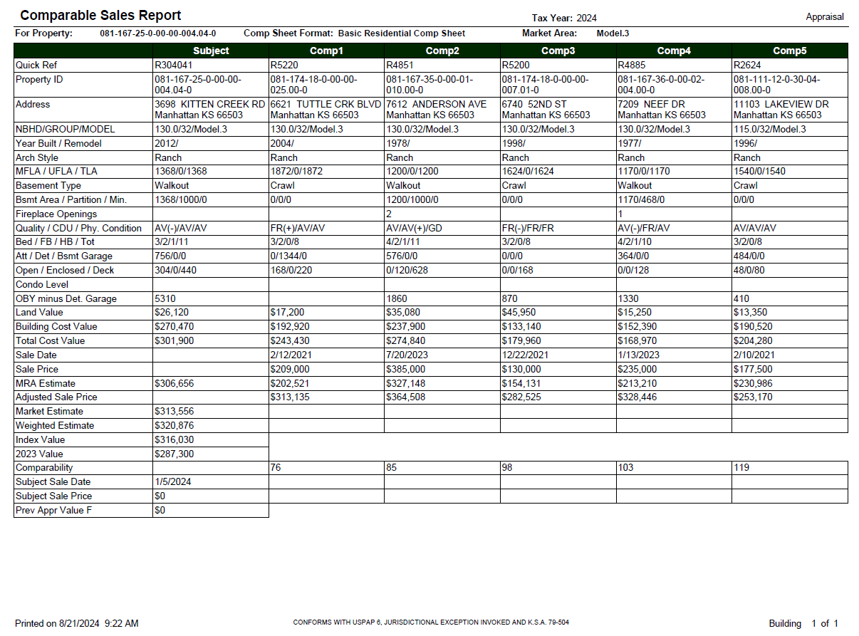
Riley

Slide 24
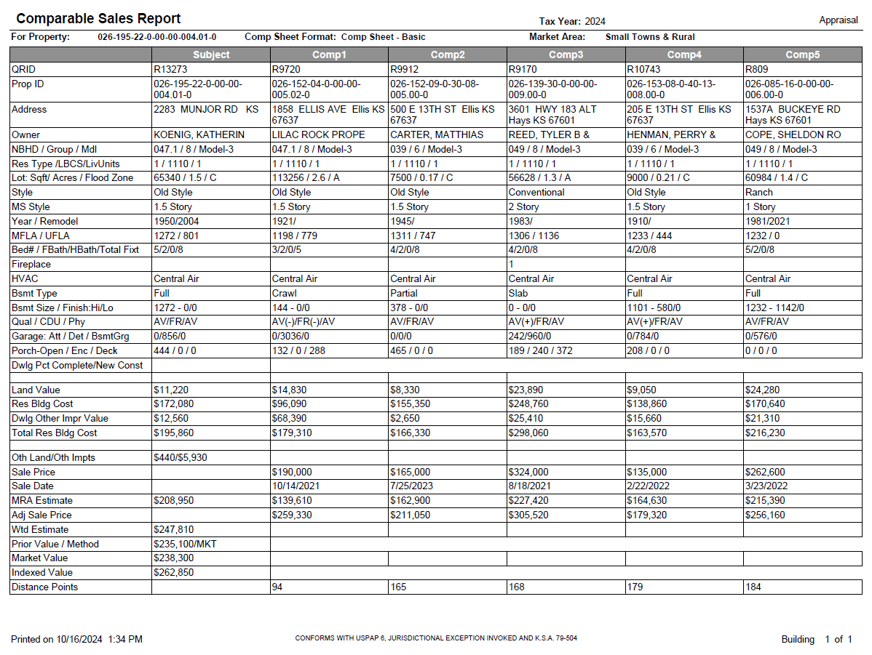
Ellis

Slide 25
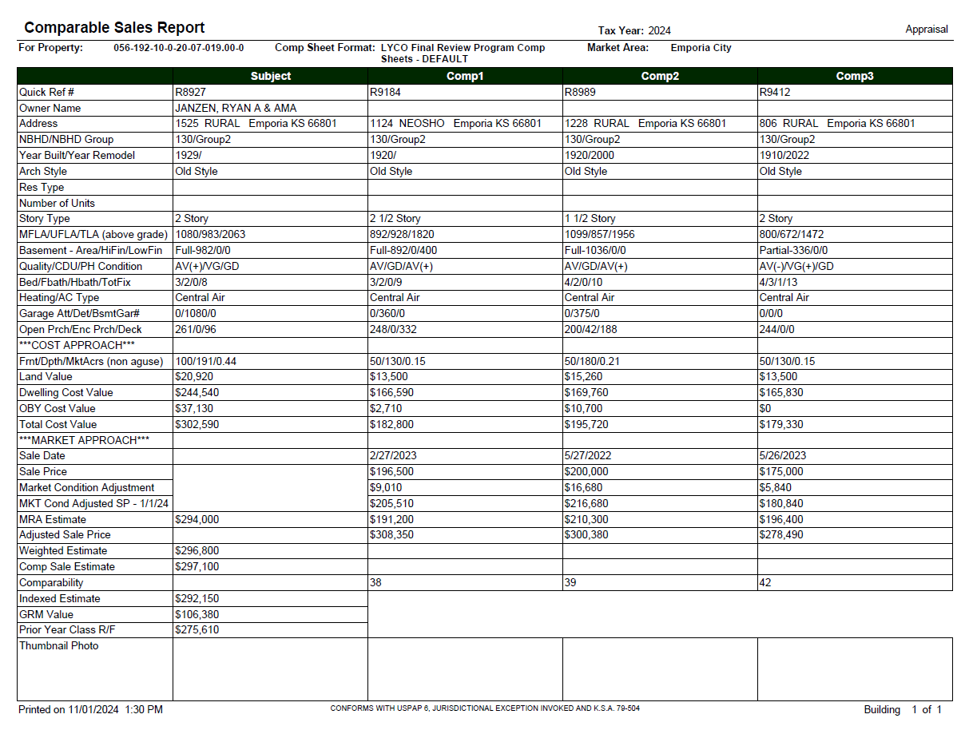
Lyon 2pg

Slide 26
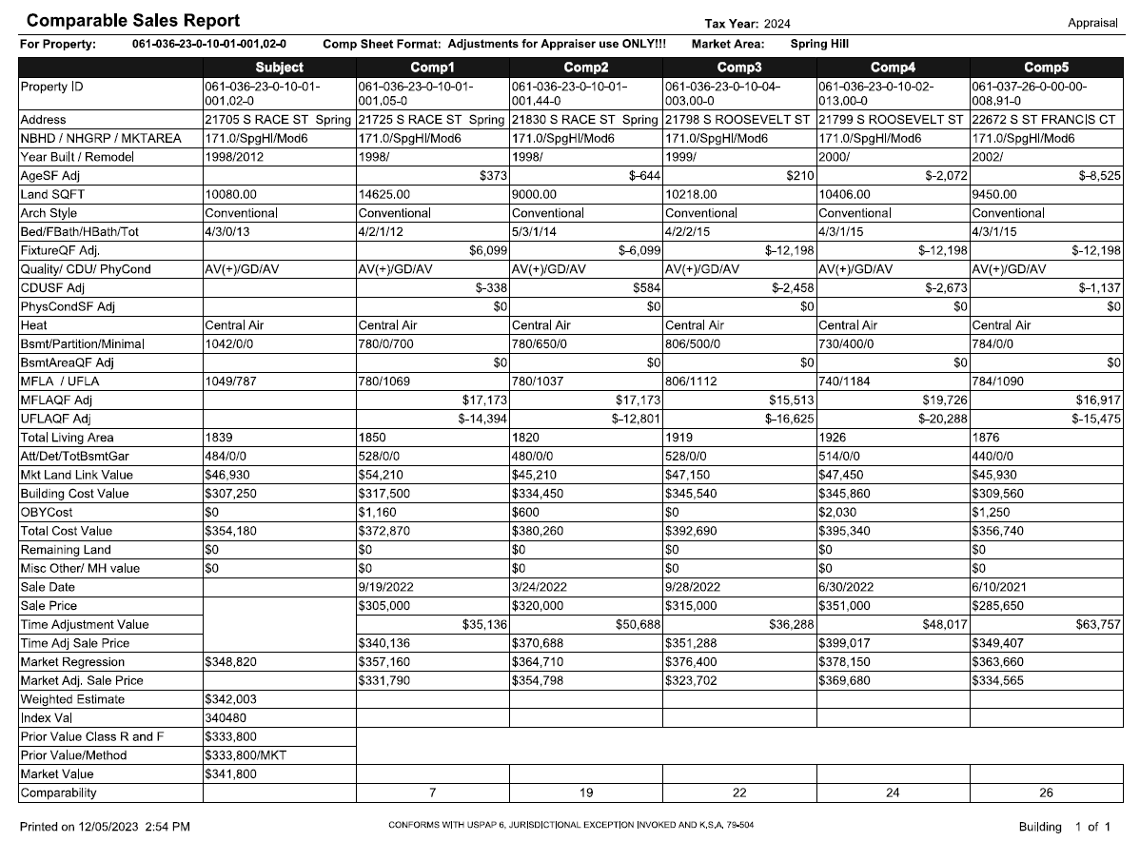
Miami Adj

Slide 27
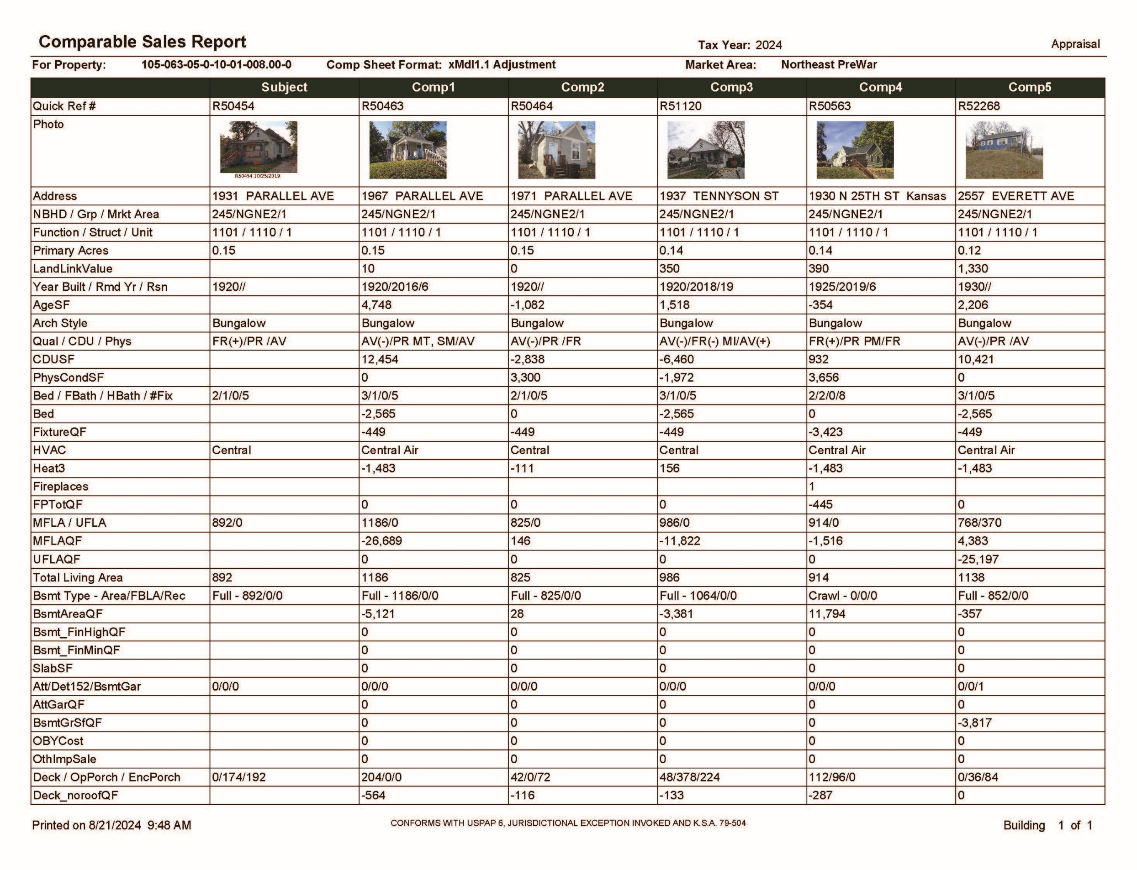
WyCo Adj 2pg

Slide 28
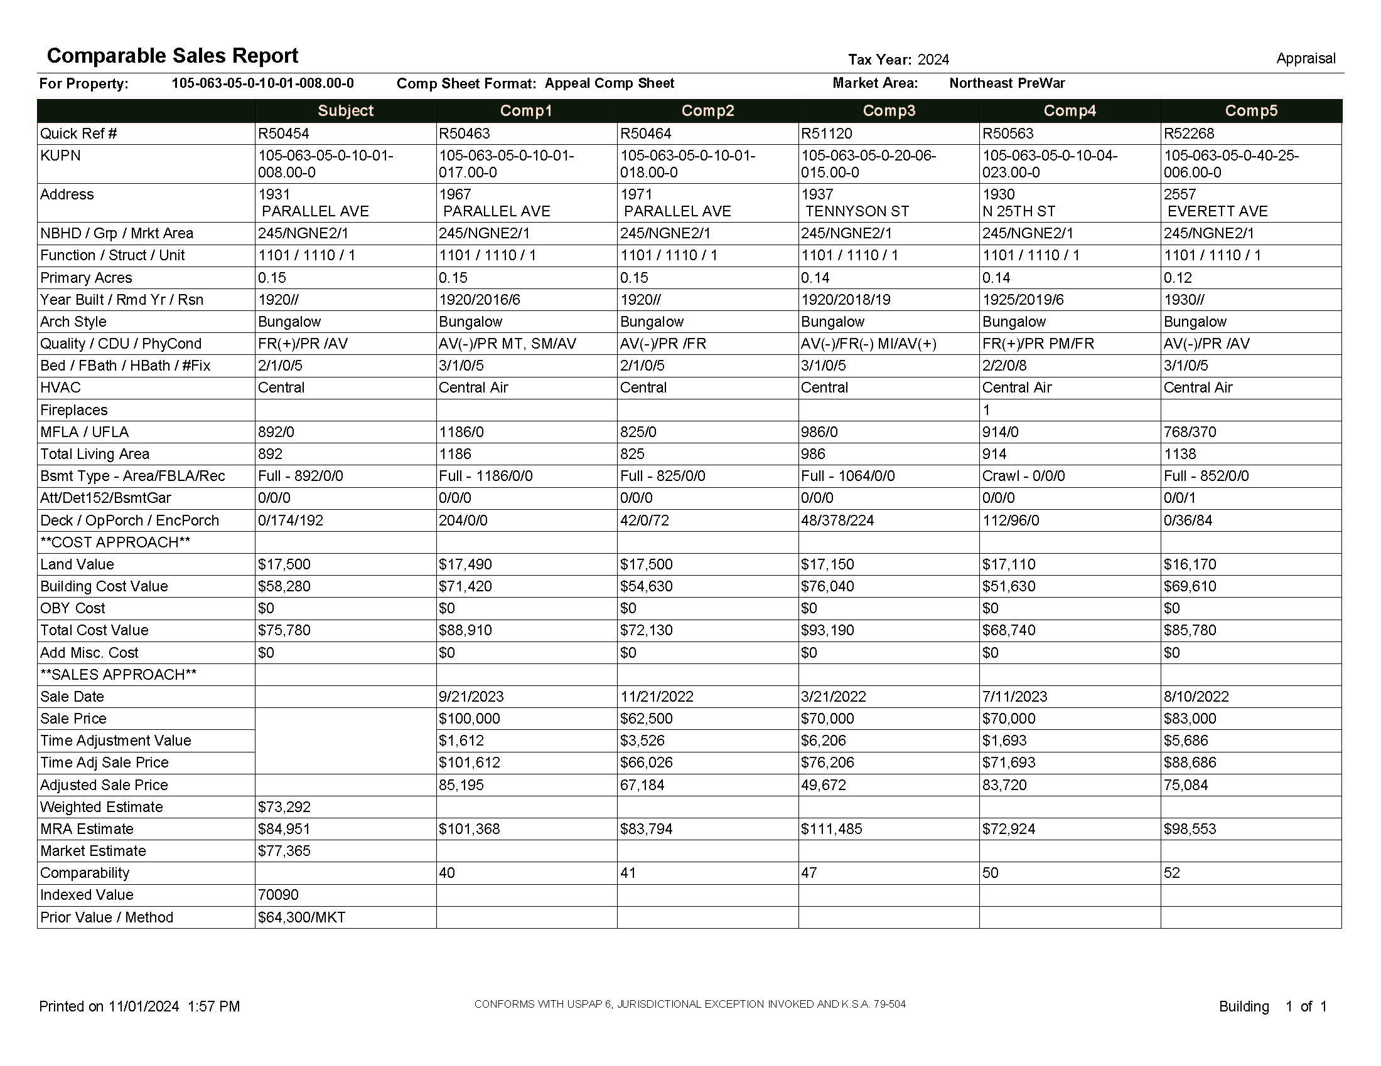
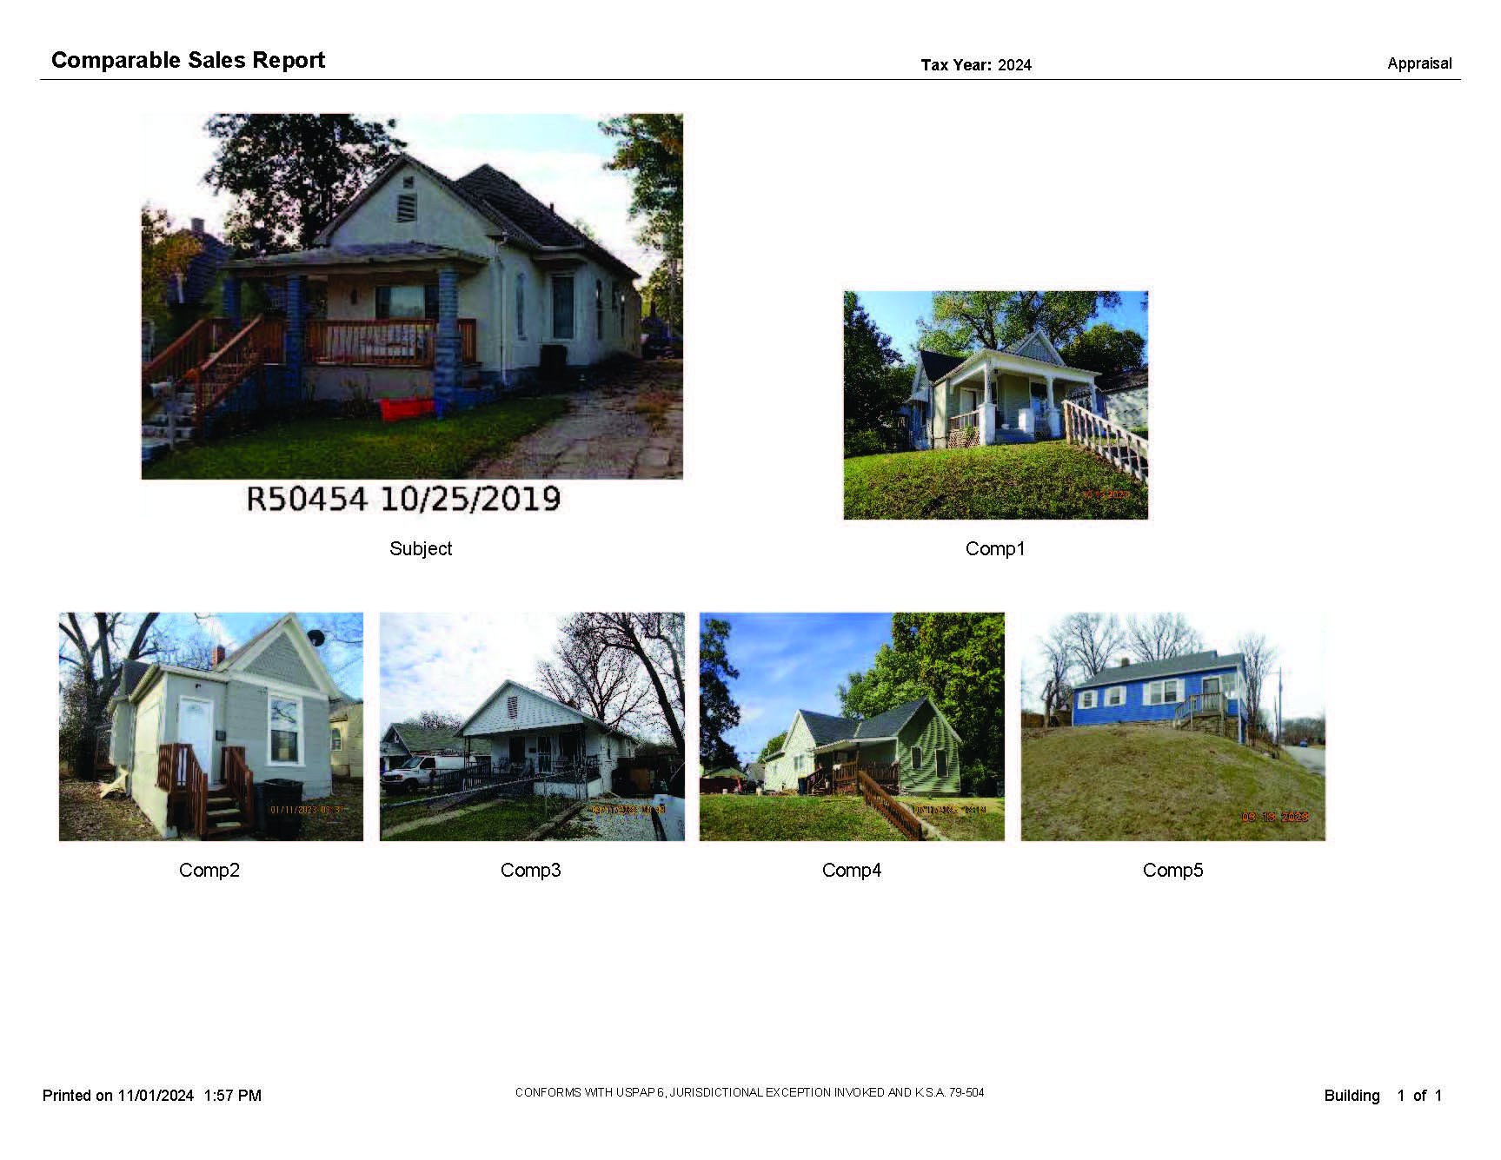
WyCo Appeal

Slide 29
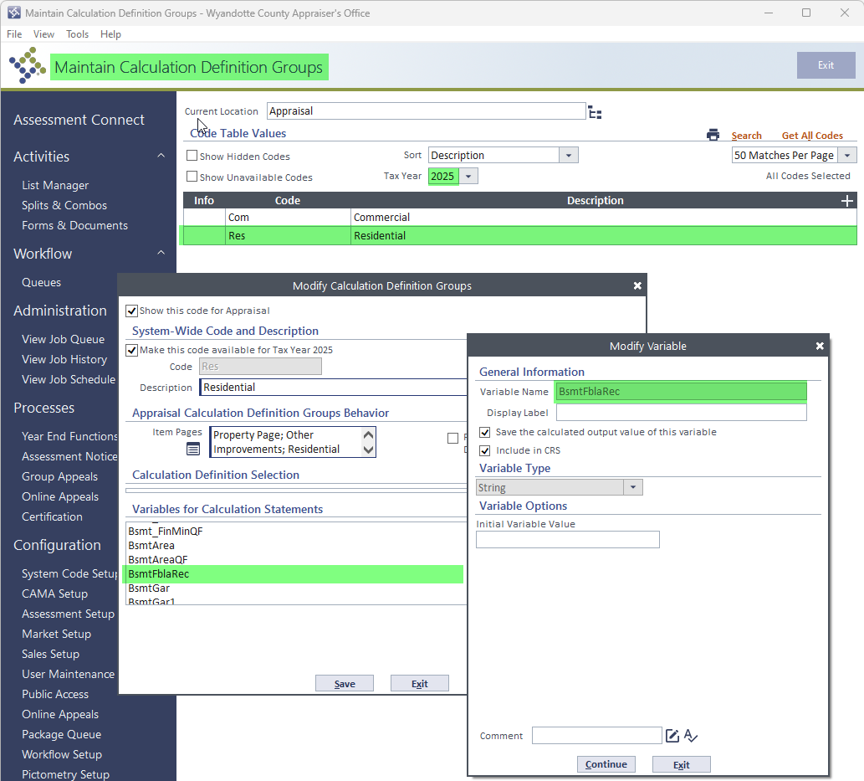
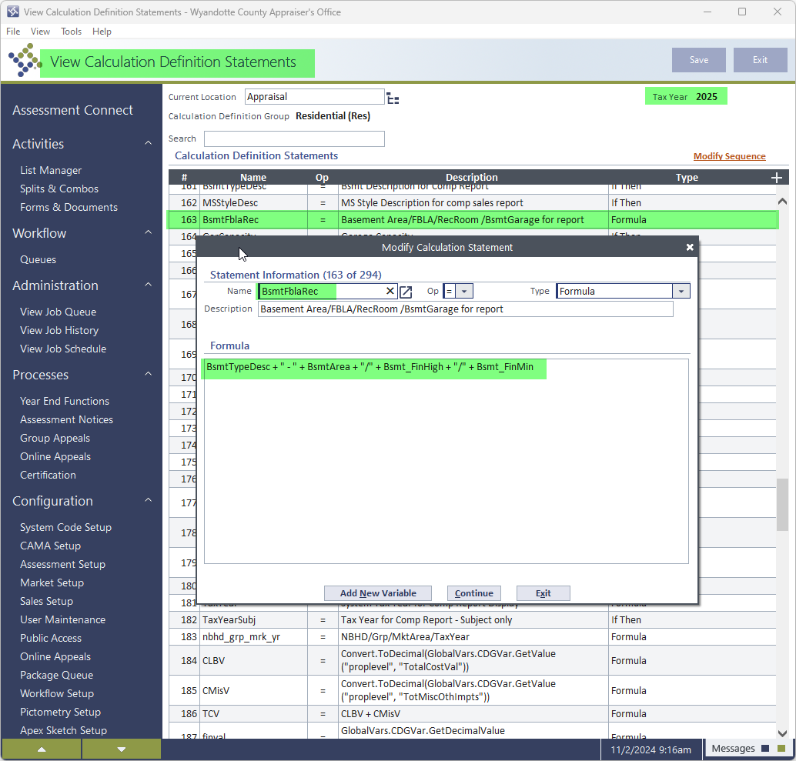
Calc Def Group
Calc Statement
Variables

Slide 30
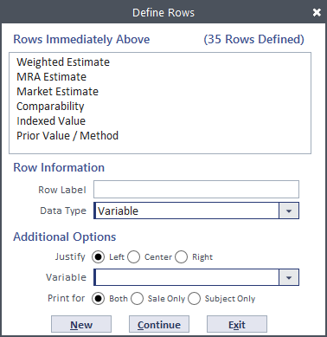
Data Type: Select the type of row from the following options:
Variable: prints the results of any of the market variables in the market calculation definition group.
None: inserts a blank row in the report. This allows you to provide a visual break between the sections of the report.
CAMA code: prints the CAMA code and/or description for the property.
Pre-defined: selects from a set of pre-defined calculations that have characteristics that cannot easily be handled with user-defined calculations.
Adjustments: prints the amount of adjustments made to each sale property. These adjustments print for the sale properties only after you specify the market variable.
Flags: prints flags that are on specified sale properties.
Thumbnail Photo: includes a thumbnail picture of the property.
Photo-separate Page: prints property pictures on a separate page. No additional options are available for this selection.
This read-only section shows you the rows that will be printed immediately above the current row. This helps you know where you are in the list when defining the rows for the comparable sales report layout.
Type the name of the row as you would like it displayed on the report. The name can be up to 30 characters in length, including spaces. If you don't want the row to have a label, leave this field blank.
Select whether you want the information in this row aligned on the left side, the right side, or the center of the column.

Slide 31
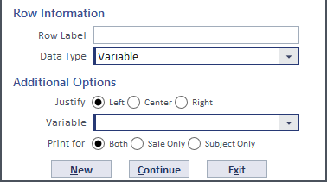
Select the appropriate variable from the list for the calculation definition group assigned to the market set. You can also press F4 to select a code.

Slide 32
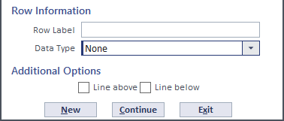
Select this check box to print a line above the row.
If you want to print a line below the row, select this check box.

Slide 33
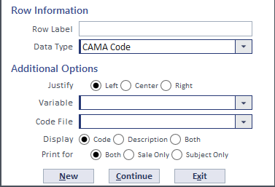
Select the appropriate variable from the list for the calculation definition group assigned to the market set. You can also press F4 to select a code.
Select the CAMA code file you want to use for the row. You can also press F4 to select a code.
Select whether to print the Code, Description, or Both the code and description for the CAMA code.

Slide 34
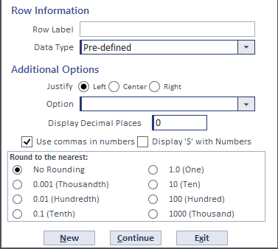
Select which of the following pre-defined options you want to print in the report:
Select Adjusted Sale Price to print the adjusted sale price for the sale properties only.
Select Comparability to print the distance points for the sale properties only.
Select Weighted Estimate to print the weighted estimate for the subject property only.
Select Market Value to print the final estimate of market value for the subject property only.
Select Field Control Code to print the field control code for the subject property only.
This field is displayed if No Rounding is selected in the Round to the nearest section. Type how many positions to the right of the decimal point you want printed. The maximum number is six.
Select this check box if you want commas printed in the values.
Select this check box if you want a dollar sign printed in front of each value.
Select the amount to which you want the value rounded.

Slide 35
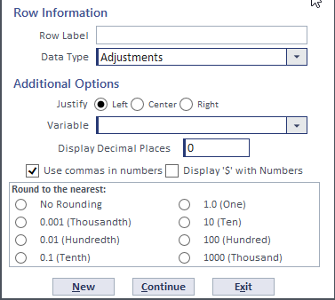
Select the appropriate variable from the list for the calculation definition group assigned to the market set. You can also press F4 to select a code.

Slide 36
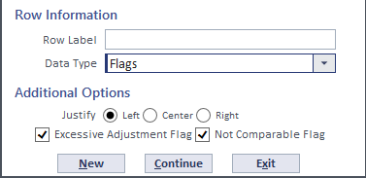
Select this check box to display this flag for the specified sales on the report. This flag indicates that the difference between the actual sale price and the adjusted sale price is greater than a user-specified threshold.
Select this check box to display this flag for the specified sales on the report. This flag indicates that a comparable was used to meet the minimum number of comparables, but the distance points exceed the maximum comparability.

Slide 37
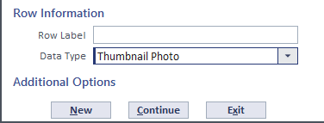

Slide 38
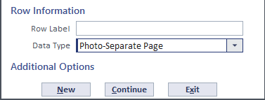

Slide 39
2024 ORION USERS CONFERENCE
Named Table Tips
01
03
05
07
Named Tables are not versioned – save versions in Excel if needed
Make sure the Calc Statements stay in order
*
Update the correct tax year
Double check the formatting when copying & pasting
*
*
02
04
06

